Slide 1

Parking Management System Project Synopsis Presentation Date : 23/09/2022
Mini Project(MCA363)
Master of Computer Applications
Project Guide:
Mr. Vineet Saxena
Prashant Shivach (TCA2163072)
Prince Kumar Yadav (TCA2163073)
Ritik Yadav (TCA2163074)
COLLEGE OF COMPUTING SCIENCES AND INFORMATION TECHNOLOGY
TEERTHANKER MAHAVEER UNIVERSITY, MORADABAD

Slide 2

Team Details
Student Name | Role
Prashant Shivach | Testing
Prince kumar Yadav | Developer
Ritik Yadav | desinger
2
T011A/ Template Version 5.0

Slide 3
Project Brief
The main objective of the Project on Parking System is to manage the details of
Parking Slots, Vehicles, Parking Fees, Duration, Types. It manages all the information
about Parking Slots, Customers, Types, Parking Slots. The project is totally built at
administrative end and thus only the administrator is guaranteed the access. The
purpose of the project is to build an application program to reduce the manual work for
managing the Parking Slots, Vehicles, Customers, Parking Fees. It tracks all the details
about the Parking Fees, Duration, Types
The project entitled Automated Car Parking system is to manage the car parking bay. This software help the company to track all the cars, car location, car in and car out details, apart from this it also help in accounting. Using this software we can track total amount collected for each day
Guidelines: Mention brief about the project and it’s functions/ modules
3
T011A/ Template Version 5.0

Slide 4
Methodologies/ Technologies/ Tools to be used
Software Platform
Front-end: IDLE (Python 3.7 64-bit)
Back-end: localhost(phpmyadmin)
Hardware Platform
RAM – 8GB
Hard Disk – 1TB
OS – Windows 10
Editor – Pycharm
Browser – Google chrome
Tools :- XMAP
4
T011A/ Template Version 5.0

Slide 5
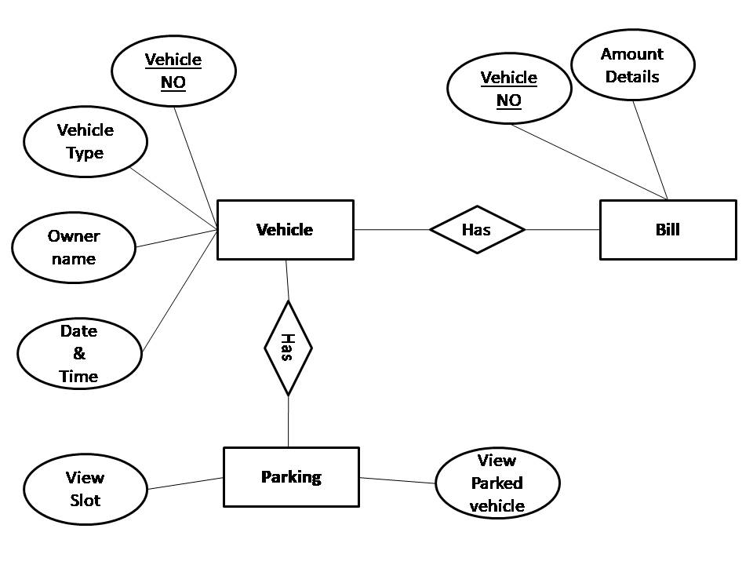
Entity Relationship Diagram (ERD)
5
T011A/ Template Version 5.0

Slide 6
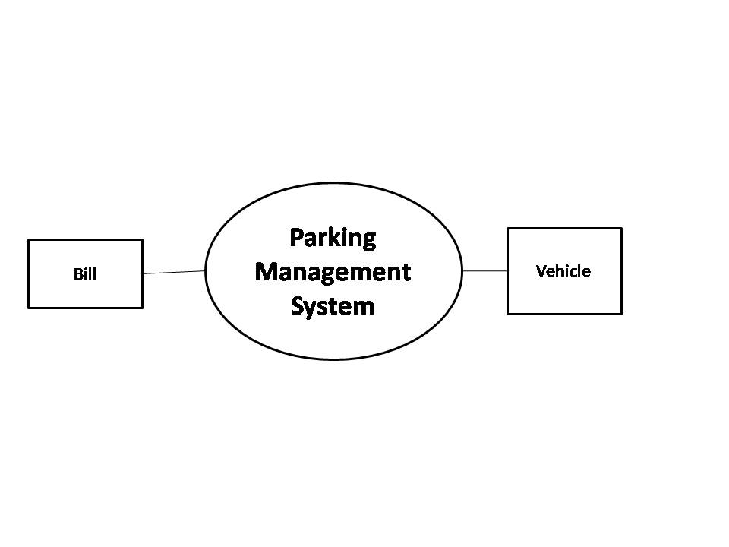
Data Flow Diagram (DFD)
Guidelines: Add more slides, if required to show all DFDs
6
T011A/ Template Version 5.0

Slide 7
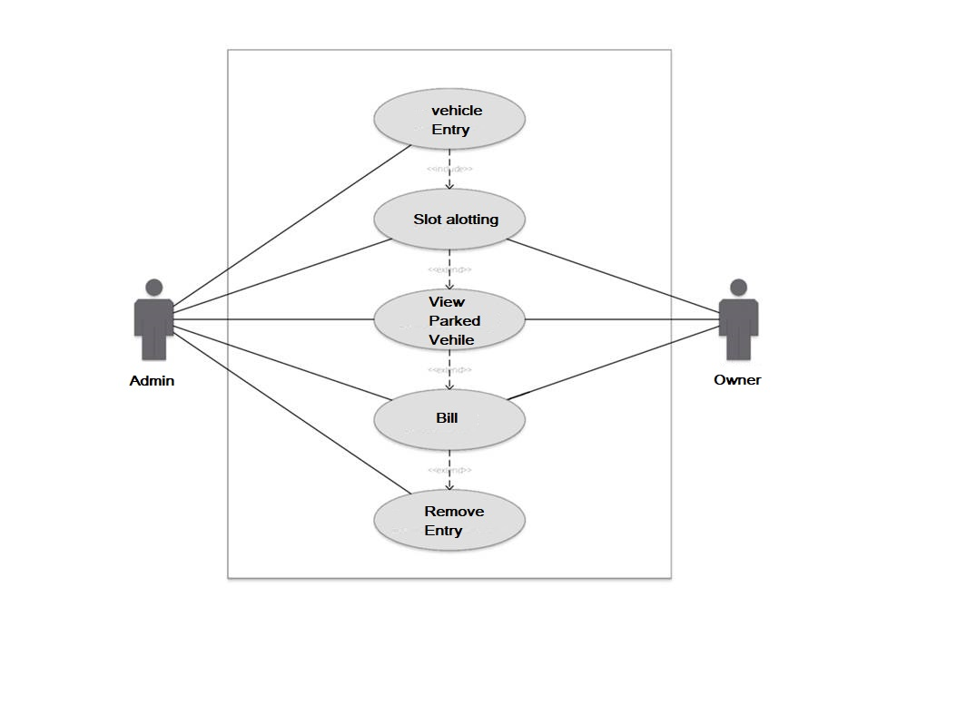
USE CASE diagram
7
T011A/ Template Version 5.0

Slide 8
\
Advantage of The Project
Advantages of this Project
Enhanced Parking
This enables drivers to quickly find the best spot available which will save time, resource and effort.
2. Reduced Congestion
Traffic flow around the parking lot will increase as overcrowding of vehicles will decrease.
3. Reduced Pollution
It goes along with reduced congestion. Smart parking opens the option of quicker parking which decreases the emissions by car standing idle in parking lot looking for space.
4. Enhanced User Experience
Parking management solution will expand and enhance the experience for a user by giving them a unified procedure. Driver's payment, spot identification, space search and time notification all becomes convenient.
5. Driver's Experience
Parking management solution helps driver find a space quickly and easily with zero frustration level. It enables them to have a seamless experience.
6. Improved Safety
Safety and security can be achieved easily by smart parking. Data can be provided to parking lot employees for better management and lookout for violations and suspicious activities.
Guidelines: Mention advantage from this project, the audience/ users who will get benefitted
8
T011A/ Template Version 5.0

Slide 9
References, if any
Google for problem solving
http://www.tutorialspoint.com/mysql/
Database Programming with pycharm
9
T011A/ Template Version 5.0

Slide 10
THANKS

